Slide 1
Questions
Please raise your hand and wait for the microphone
Please limit your questions to one to allow everyone the opportunity to speak this evening. We will return to you for follow-on questions as time allows.
Please limit your questions to the permit modifications described tonight. If you have other questions, please contact the community relations representatives listed below who will find the best resource to answer your questions.
Please fill out a survey and let us know how you would like to engage with us and learn more about BAE Systems and the Radford Army Ammunition Plant.
Resources
Charlie Saks
Public Affairs Officer
US Army
540.731.5785
charles.e.saks3.civ@mail.mil
www.rfaap.army.mil
Alicia Gray
Community Relations
BAE Systems
540.639.7709
alicia.gray@baesystems.com
www.baesystems.com
Russell McAvoy
Environmental Engineer Senior
Virginia Department of Environmental Quality,
629 East Main Street, Richmond,
VA 23219;
phone 804-698-4194
fax 804-698-4234l
russell.mcavoy@deq.virginia.gov

Slide 2
Radford Army Ammunition Plant
Review of Modification request for Radford Army Ammunition Plant RCRA Subpart X Open Burn Area Permit
23 April, 2013

Slide 3
Agenda
Introduction
BAE Systems Overview
BAE Systems Environmental Stewardship Overview
Waste Management Overview
  Open Burning Ground (OBG)
Specifics of the changes to the OBG Permit
Questions

Slide 4
Introductions
BAE Systems
Alicia Gray
Community Relations, Radford
Alicia.gray@baesystems.com
Bob Winstead
Environmental Manager, OSI
Jay Stewart
Environmental Manager, Radford
Draper Aden Associates
Michael D. Lawless, CPG, PG
Principal / Vice President
Environmental Division Manager
US Army
Charlie Saks
Public Affairs Officer, RFAAP
Charles.e.saks3.civ@mail.mil
LTC William Byron Penland
Commander, Radford Army Ammunition Plant (RFAAP)
Rob Davie
Chief, Operations Team, US Army, RFAAP

Slide 5




BAE Systems, Inc.
Led by Linda Hudson, President and CEO, BAE Systems, Inc. delivers a full range of products and services for air, land and naval forces, as well as advanced electronics, security, information technology solutions and support services.
BAE Systems, Inc. is a top-ten prime contractor to the U.S. Department of Defense and is well positioned to support customers in what is the world’s largest single defense market.
Key Facts:
Employs 40,100 (34,000 in the U.S.) with major operations in 38 states, the UK, Sweden, Israel, and South Africa
Recorded 2012 sales of $12.75bn
The U.S.-based business operates under a Special Security Agreement
Holds more than 2,100 U.S. and foreign patents across technology domains
Comprises four U.S.-headquartered business sectors:
  Electronic Systems
  Intelligence & Security
  Land & Armaments
  Support Solutions

Slide 6
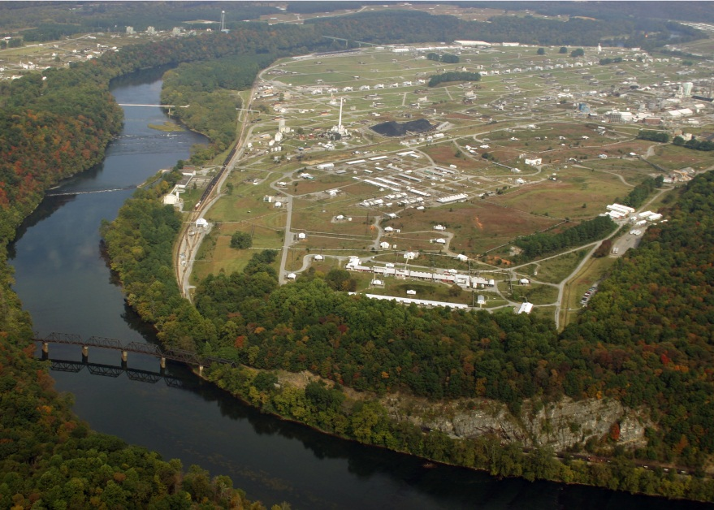
Ordnance Systems Inc.
_{BAE Systems, Plc.}
_{BAE Systems, Inc.}
_{Support Solutions}
_{Ordnance Systems, Inc.}
Radford Army Ammunition Plant
Employs over 750 people in Radford, VA and the surrounding communities

Slide 7
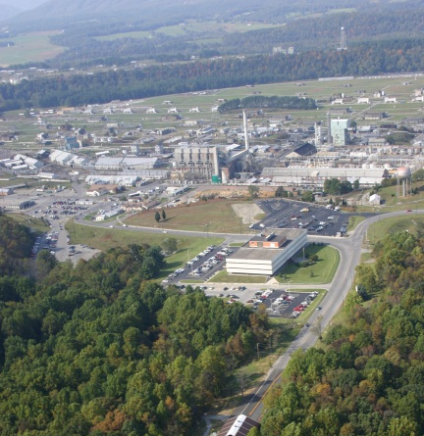

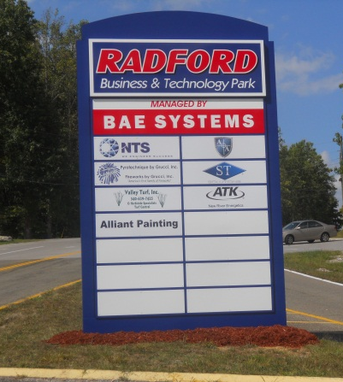
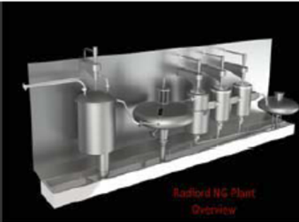

Site General Overview -- Mission
25 Year Facility Use | Propellant Supply | Site Commercial Development | Research & Development | Modernization
Facility O&M Utilities SHE Compliance Physical Security Energy Management | DoD Directed Agile Mfg ~75 Products | ARMS Program 11 Tenants | New Propellants IM Formulations | Infrastructure Single-point Failures New Technology Compliance

Slide 8

BAE Systems Environmental Stewardship
.
In partnership with the US Army and the United Steel Workers Union, BAE Systems and all of its employees will operate the Radford facility in a manner that strives to meet the needs of our current generation of Warfighter without compromising the resources of future generations in the New River Valley. The employees of Team Radford will comply with all applicable legal requirements to promote environmental protection and enhancement and exceed those requirements when possible.

Slide 9
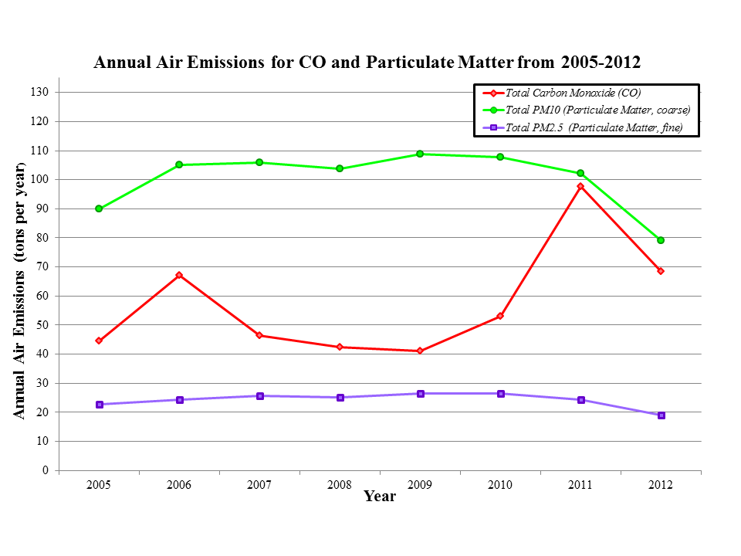
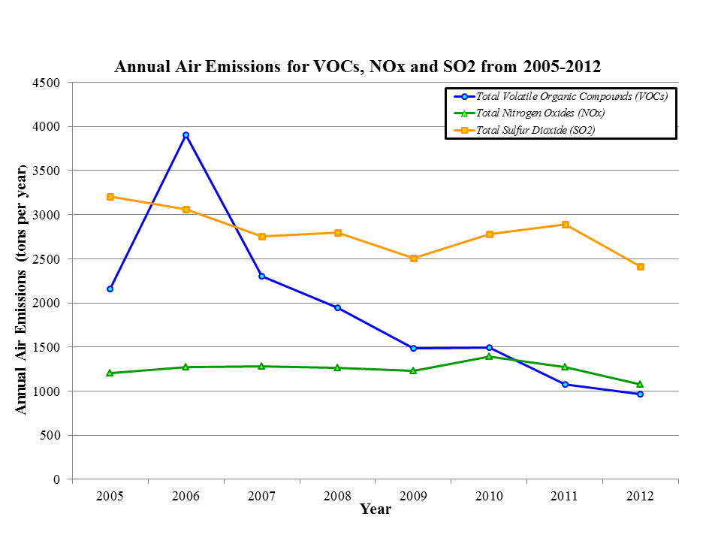
Robust Air Tracking and Reporting

Slide 10
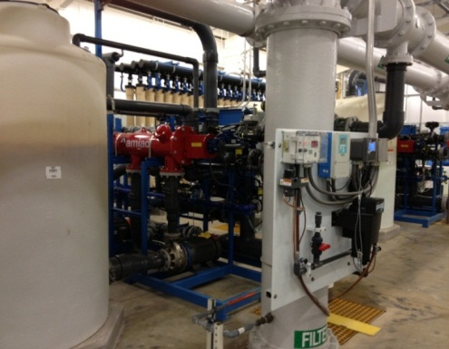
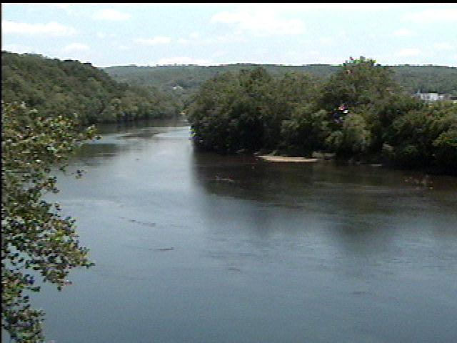
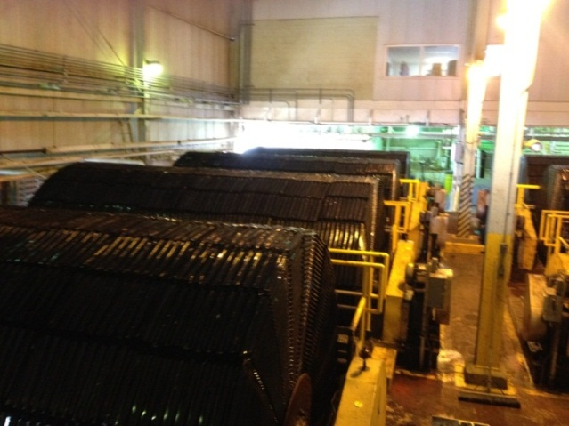
Water Management
Water Filtration Plant
Two Drinking Water Facilities
Operations
XXX Storm Water Outfalls
3 Major Waste Water Treatment Facilities

Slide 11

Waste Management
BAE’s defined policy for dealing with nitrocellulose and other energetic wastes is:
  REDUCE Waste generation at the various sources
    RECYCLE propellant where safe and allowed by military specifications.
      Proper DISPOSAL in accordance with all Virginia Department of Environmental Quality (DEQ) and Federal Environmental Protection Agency (EPA) regulations and requirements.

Slide 12
Energetic Waste Disposal Process
Screening
Free of Foreign Objects
Grinder
Contains Foreign Objects
Open Burning Ground
Maximum Achievable Emission Control Technology
Incinerator
Energetic Waste
Open burning is the safest disposal route of last resort

Slide 13
Modification Request Sent to the DEQ
Item
Modification of Module IV
  Detection Monitoring
Modification of Attachment IV.A
  Groundwater Monitoring Program Sampling and Analysis Plan
Modification of Module V
  Groundwater Compliance Monitoring Program
Modification of Module VII
  Corrective Action and Groundwater Monitoring Program
Modification of Module III
  Operating Conditions

Slide 14
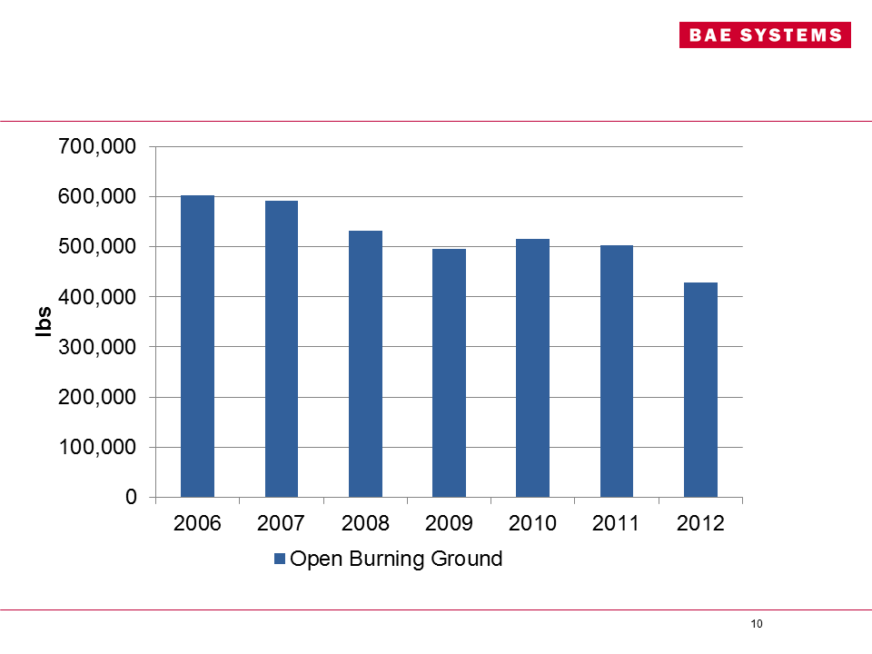
Why did BAE Systems ask for a change in small burn chromium concentrations?
Due to a decrease in total energetic wastes going to the open burn area, BAE Requested a change in the Chromium concentration for small (500 pound) burns in order to increase operational flexibility, NOT an increase in total Chromium emissions.
Total Energetic Wastes going to OBG
Grams Chromium
Grams Chromium
Size of skid burn

Slide 15
Questions
Please raise your hand and wait for the microphone
Please limit your questions to one to allow everyone the opportunity to speak this evening. We will return to you for follow-on questions as time allows.
Please limit your questions to the permit modifications described tonight. If you have other questions, please contact the community relations representatives listed below who will find the best resource to answer your questions.
Please fill out a survey and let us know how you would like to engage with us and learn more about BAE Systems and the Radford Army Ammunition Plant.
Resources
Charlie Saks
Public Affairs Officer
US Army
540.731.5785
charles.e.saks3.civ@mail.mil
www.rfaap.army.mil
Alicia Gray
Community Relations
BAE Systems
540.639.7709
alicia.gray@baesystems.com
www.baesystems.com
Russell McAvoy
Environmental Engineer Senior
Virginia Department of Environmental Quality,
629 East Main Street, Richmond,
VA 23219;
phone 804-698-4194
fax 804-698-4234l
russell.mcavoy@deq.virginia.gov

